Slide 1
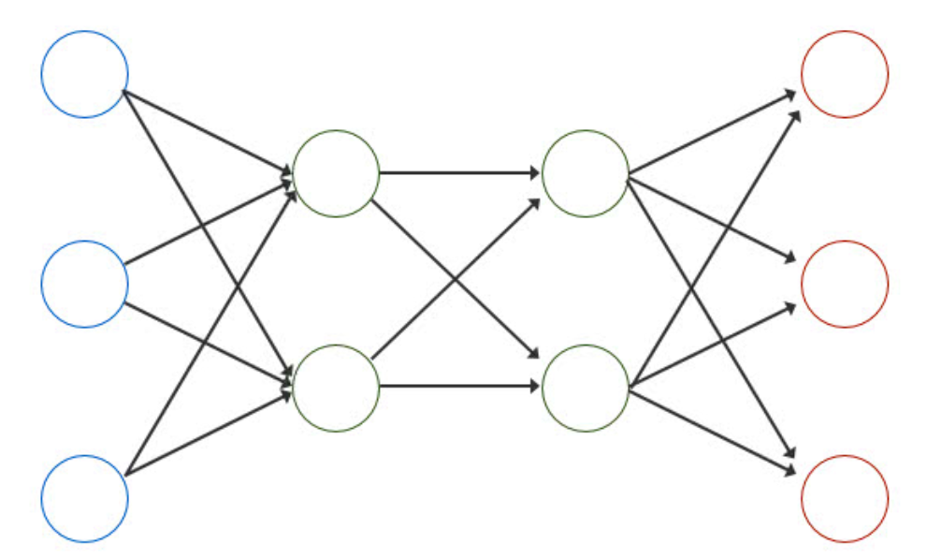
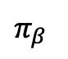

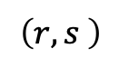
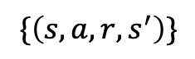
Weekly Report
Model-based offline RL(MOPO)
$π_{β}$
$$\left(r,s \right)$$
env
$$\{\left(s,a,r,s^{′}\right)\}$$
model
agent
$$\left(s,a\right)$$

Slide 2

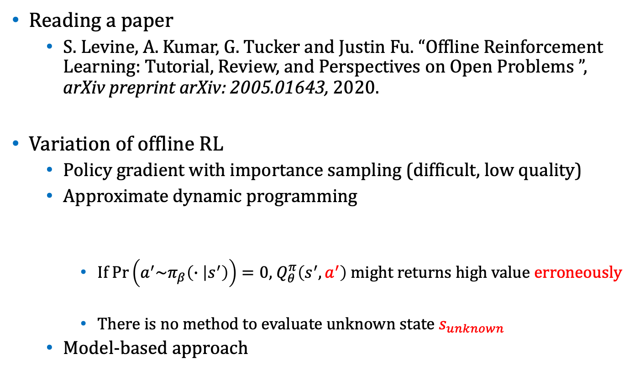
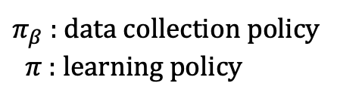
Weekly Report
Reading a paper
S. Levine, A. Kumar, G. Tucker and Justin Fu. “Offline Reinforcement Learning: Tutorial, Review, and Perspectives on Open Problems ”, arXiv preprint arXiv: 2005.01643, 2020.
Variation of offline RL
Policy gradient with importance sampling (difficult, low quality)
Approximate dynamic programming
$\text{If} Pr\left(a^{′}\sim π_{β}\left(∙ | s^{′}\right)\right)=0,$ $Q_{θ}^{π}\left(s^{′},a^{′}\right)$ might returns high value erroneously
There is no method to evaluate unknown state $s_{unknown}$
Model-based approach
$π_{β}$ : data collection policy
$π$ : learning policy
$$Q_{θ}^{π}\left(s,a\right)=r\left(s,a\right)+γ𝔼_{a^{′}\sim π(∙|s^{′})}\left[Q_{θ}^{π}\left(s^{′},a^{′}\right)\right]$$
Action distributional shift
(State shift can be ignored)

Slide 3
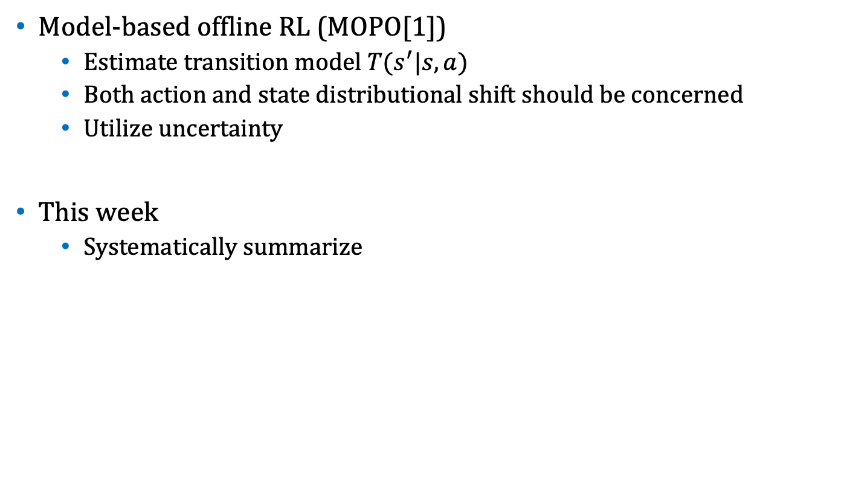
Weekly Report
Model-based offline RL (MOPO[1])
Estimate transition model $T(s^{′}|s,a)$
Both action and state distributional shift should be concerned
Utilize uncertainty
This week
Systematically summarize
[1] : T.Yu,G.Thomas,L.Yu,S.Ermon,J.Zou,S.Levine,C.FinnandT.Ma. “MOPO: Model-based Offline Policy Optimization” arXiv preprint arXiv: 2005.13239, 2020.

